Slide 1
Generating Adversarial Examples using Parallel Genetic Algorithm
Kira Chan
Department of Computer Science and Engineering
Michigan State University
CSE847

Slide 2
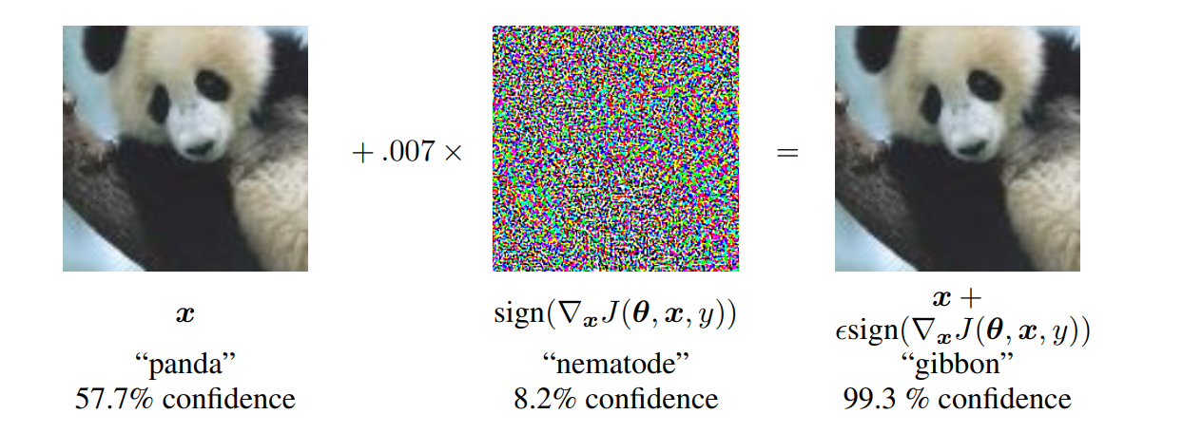
Introduction
Adversarial examples: maliciously modified input images that causes the underlying model to fail to predict the input.
Ex: A deep neural network (DNN) predicting a horse correctly. Adding a layer of noise causes it to predict the image as a frog.
Img credit: Goodfellow et al.

Slide 3
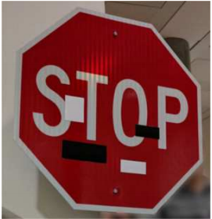
Motivation
Safety Critical Systems
Virus detection in anti-virus software
Botnet detection
Image Recognition
Eykholt et al.’s attack on stop signs

Slide 4
Current mitigation strategies
Detection network (add on)
Modifying or detection on input data
Modifying original network
Retrain the current network with adversarial examples to make them more robust
There are many ways to create adversarial example, this project proposes an evolutionary approach.

Slide 5
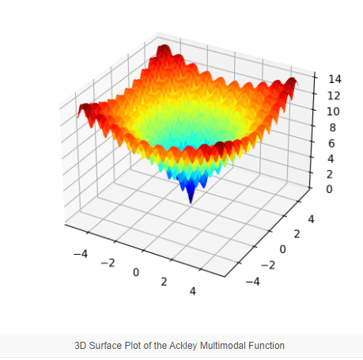
Evolutionary Computing (Genetic Algorithm)
Start with a population of individuals, each chosen randomly across the solution space
By mutation and crossover, members in the population moves towards the global optimum.
Img src: https://machinelearningmastery.com

Slide 6
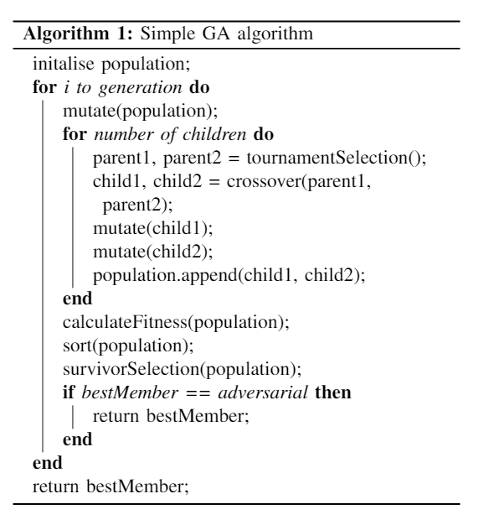
Genetic Algorithm

Slide 7
Parallel GA
Parallel GA uses multiple island of population that co-evolve independently.
In the solution space, each population are essentially exploring a different subregion.
Every N generation, some individuals migrate to another island to prevent premature convergence.

Slide 8
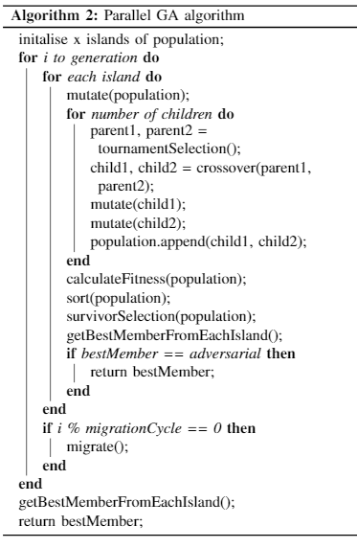

Slide 9
Experiments:
Model used: ResNet-20 provided by Mick Langford
Dataset: CIFAR10 (32x32 images)
Set of images with 10 ground truth labels
Ex: cat, horse, ship, truck, automobile, etc.
Metric used: MSE (l2 norm) distance between original and output.

Slide 10
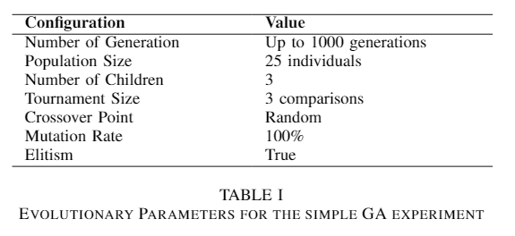
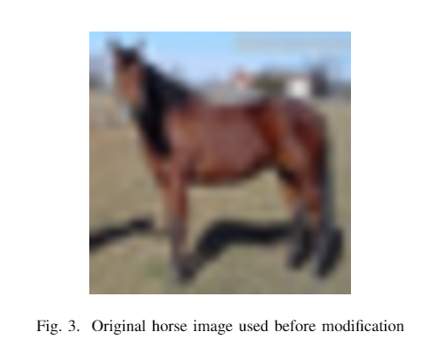
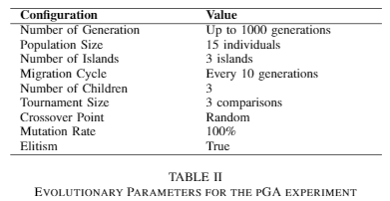
Experiment 1: GA vs pGA

Slide 11
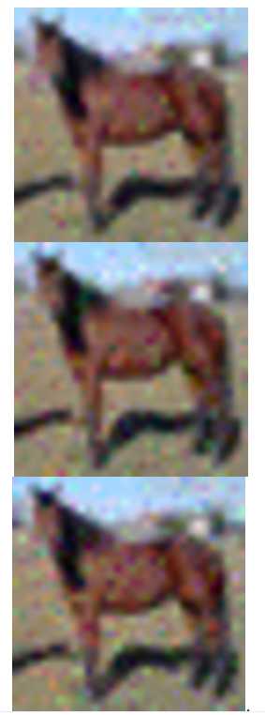
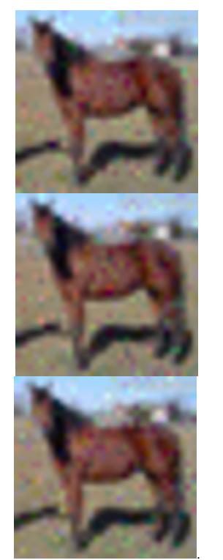
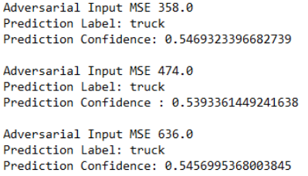
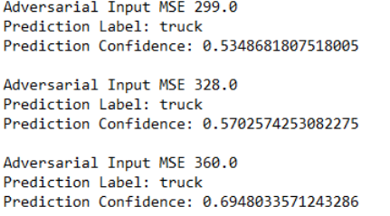
GA vs pGA

Slide 12
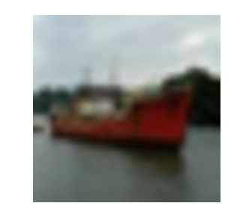
Experiment 2: high confidence misclassification
We increase the fitness criteria to evolve images that are misclassified with a high confidence score of more than 90%
Intuitively, the MSE increases because it should take more perturbation to make the model mispredict with higher probability
The corresponding image should be rarer to find.

Slide 13
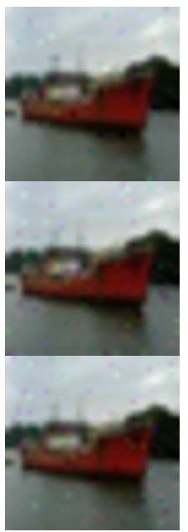
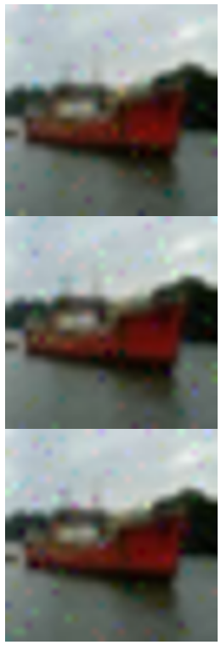
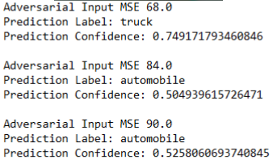
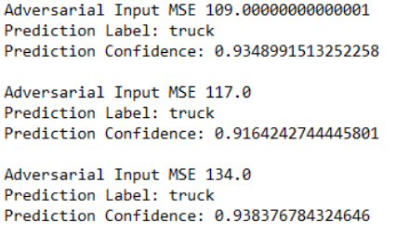
Right: regular - Left: >90% confidence

Slide 14
Conclusion
Adversarial examples are maliciously modified images that the model labels incorrectly, but a human can still correctly identify
Using evolutionary computing, we evolve adversarial examples that the model mispredicts with more than 50% confidence and 90% confidence
Future work will consider the robustness of the model by retraining the model with images generated by the algorithm and other dataset with higher image resolution.

